Slide 1
A real life problem (p-value)
In our lives, we certainly believe one thing over another.
From the obvious ones like — The earth is round. Or that the earth revolves around the Sun. The Sun rises in the east.
To the more non-obvious ones with varying level of uncertainties — Exercising reduces weight? Or that Trump is going to win/lose in his next election? Or that a particular drug works? Or that sleeping for 8 hours is good for your health?
While the former category is facts, the latter category differs from person to person.
So, what if I come to you and say that exercising does not affect weight?
Is there a mathematical and logical structure in which someone can disprove me?

Slide 2
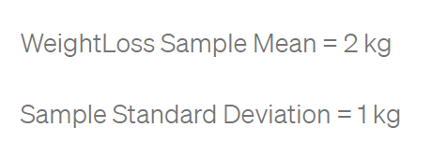
Hypothesis testing.
We collect Data. We collect weight loss data for a sample of 10 people who regularly exercise for over 3 months.
Does this prove that exercise does reduce weight?
it sort of looks like that exercising does have its benefits as people who exercise have lost on an average 2 kgs.
What if the weight loss mean for people who do exercise was just 0.2 kg. Would you still be so sure that exercise does reduce weight?

Slide 3
So how can we quantify this and put some maths behind it all?
Let’s go back to our Hypotheses again:
Null Hypthesis : Exercising does not affect weight. Or equivalently 𝜇 = 0
Alternate Hypothesis : Exercise does reduce weight. Or equivalently 𝜇>0
We see our data sample of 10 people, and we try to find out the value of
Observed Mean(Weightloss of People who exercise) = 2 kg
Observed Sample Standard Deviation = 1 kg
Assuming that the null hypothesis is true, what is the probability of observing a sample mean of 2 kg or more extreme than 2 kg?
Assuming we can calculate this — If this probability value is lesser than a threshold value, we reject our null hypothesis. And otherwise, we fail to reject our null hypothesis.

Slide 4
The statisticians call the threshold as the significance level(𝜶), and in most of the cases, 𝜶 is taken to be 0.05
This probability value is actually the p-value. Simply, it is just the probability of observing what we observed or extreme results if we assume our null hypothesis to be true.
But It will be calculated the same way
Probability
Equal
Rarer
So how do we answer: Assuming that the null hypothesis is true, what is the probability of getting a value of 2 kg or more than 2 kg?
Our answer starts with Central Limit Theorem

Slide 5
Central limit theorem and law of large numbers
Central Limit Theorem: The central limit theorem simply states that if you have a population with mean μ and standard deviation σ, and take random samples from the population, then the distribution of the sample means will be approximately normally distributed with mean as the population mean and standard deviation σ/√n. Where σ is the standard deviation of the sample and n is the number of observations in the sample.
(6) Central limit theorem | Inferential statistics | Probability and Statistics | Khan Academy - YouTube
Law of large numbers: It states that if you repeat an experiment independently a large number of times and average the result, what you obtain should be close to the expected value.
Law of Large Numbers - Explained and Visualized - YouTube
Why am I talking about CLT and Law of large numbers : Because here’s an important generalization in mathematics. According to CLT we can assume any distribution if sampled randomly to be a Normal Distibution. This will be even more true if we increase the size of n from 10 to 10000
Fitting to our context : We can assume the sample to be normally distributed around the Population Mean 0 and with Standard Deviation of σ/√n

Slide 6
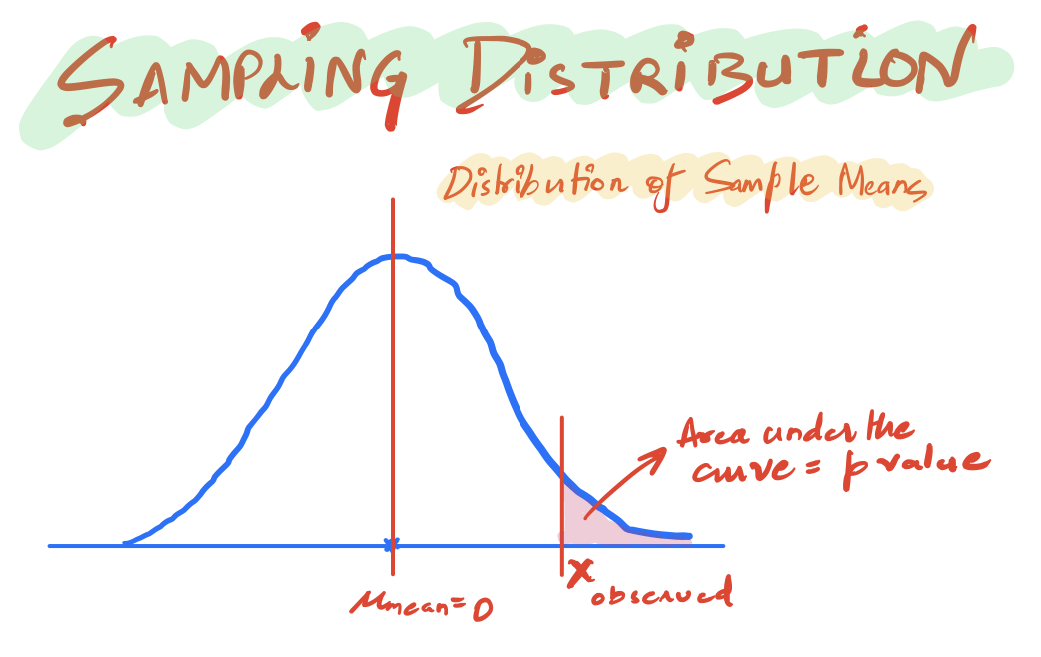
The normal distribution
Now we already know the mean of our population as given by our null hypothesis. So, we use that and have a normal distribution whose mean is 0. And whose standard deviation is given by 1/√10
This is, in fact, the distribution of the mean of the samples from the population. We observed a particular value of the mean that is Xobserved = 2 kg.

Slide 7
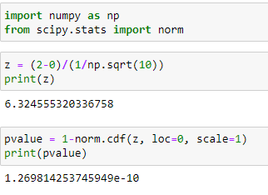
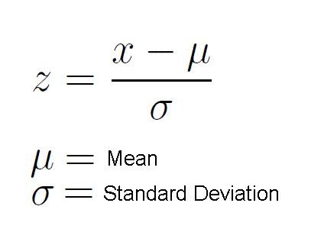
Z-value

Slide 8
Conclusion
As such, this is a very small probability p-value (<significance level of 0.05) for the mean of a sample to take a value of 2 or more.
And so we can reject our Null hypothesis. And we can call our results statistically significant as in they don’t just occur due to mere chance
In essence, hypothesis testing is just about checking if our observed values make the null hypothesis look ridiculous. If yes, we reject the null hypothesis and call our results statistically significant. P-value helps test that.

Slide 9
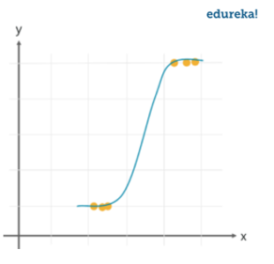
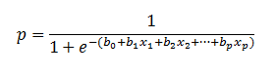
Logistic regression

Slide 10
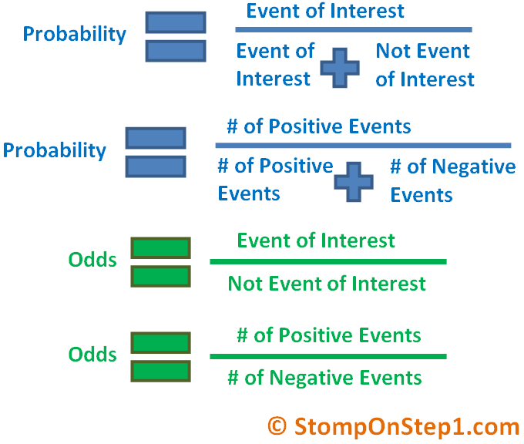
Do you the difference between odds and probability

Slide 11
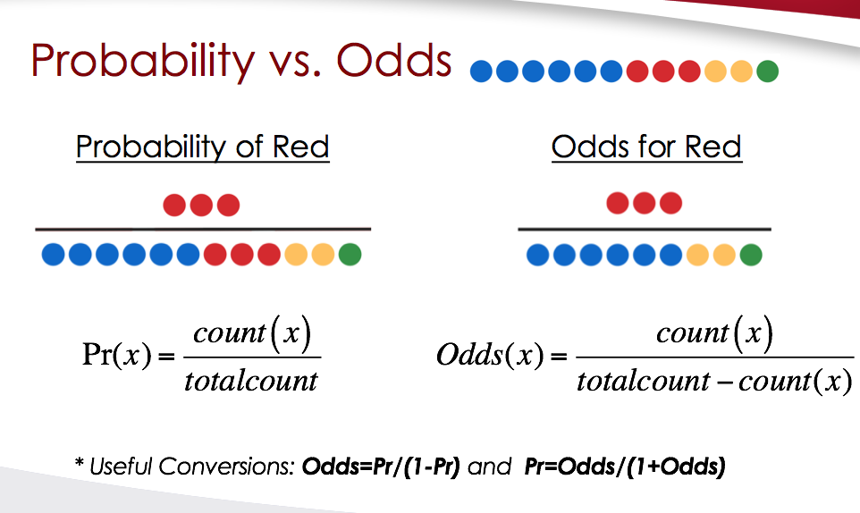

Slide 12
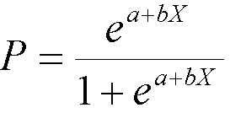
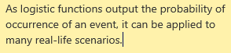
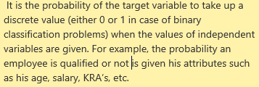
Logistic regression
What is a logistic function? What is the range of values of a logistic function
Why is logistic regression very popular?
How can the probability of a logistic regression model be expressed as conditional probability?

Slide 13
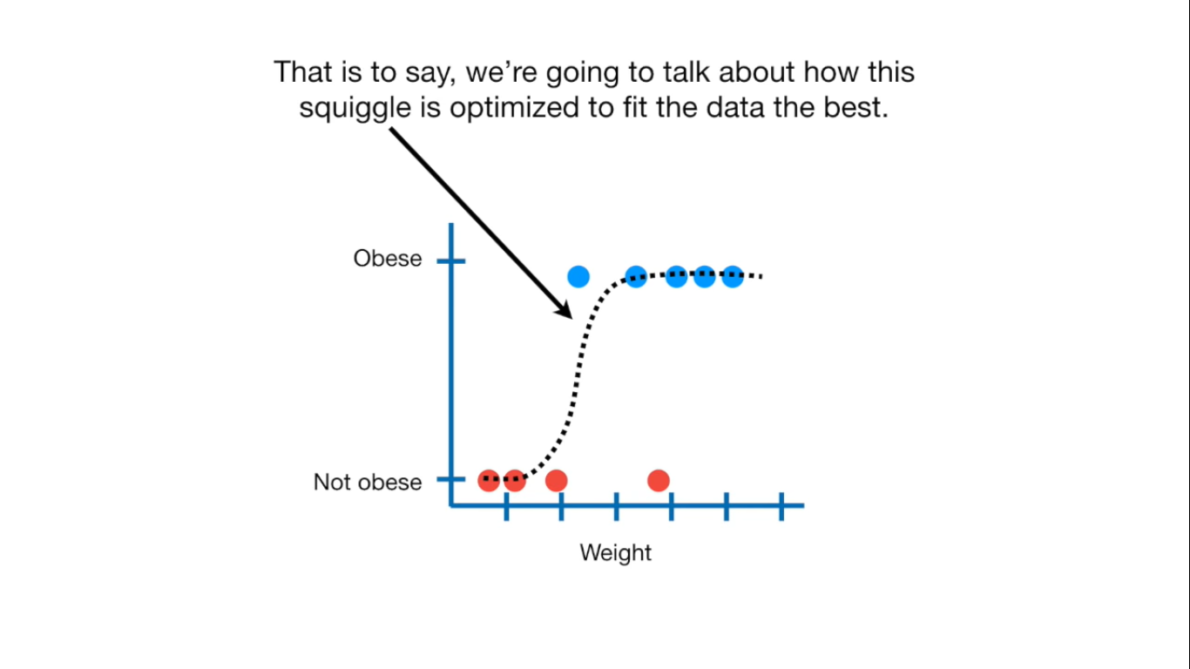
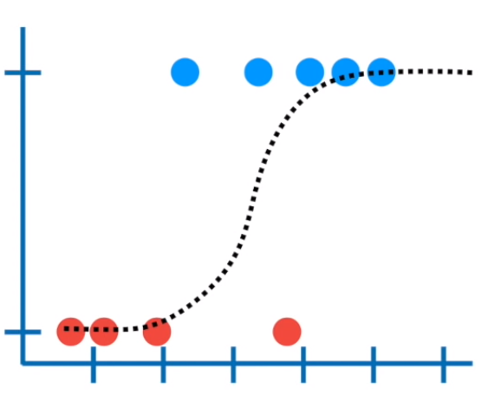

Slide 14
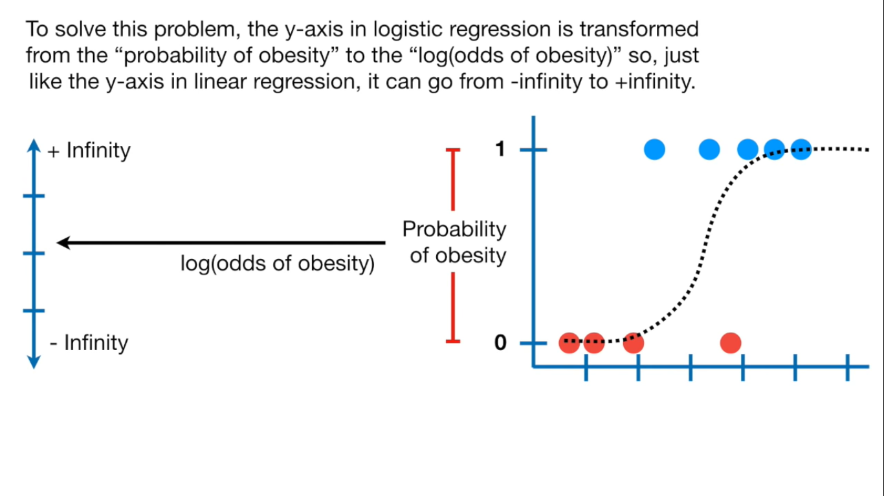

Slide 15
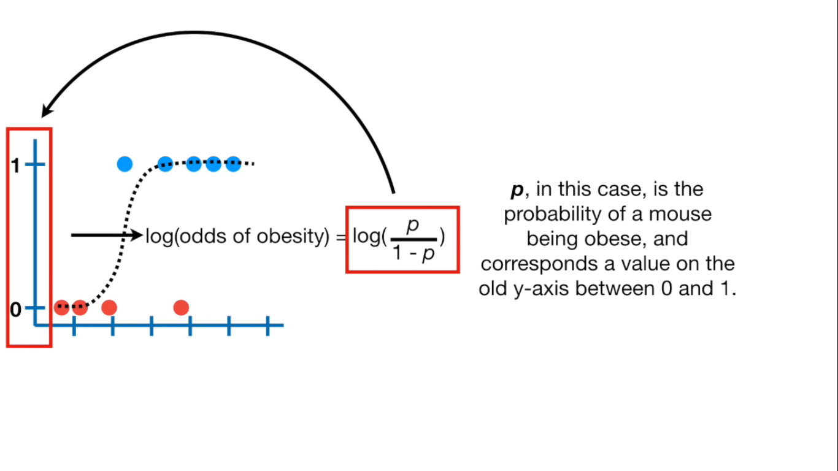

Slide 16
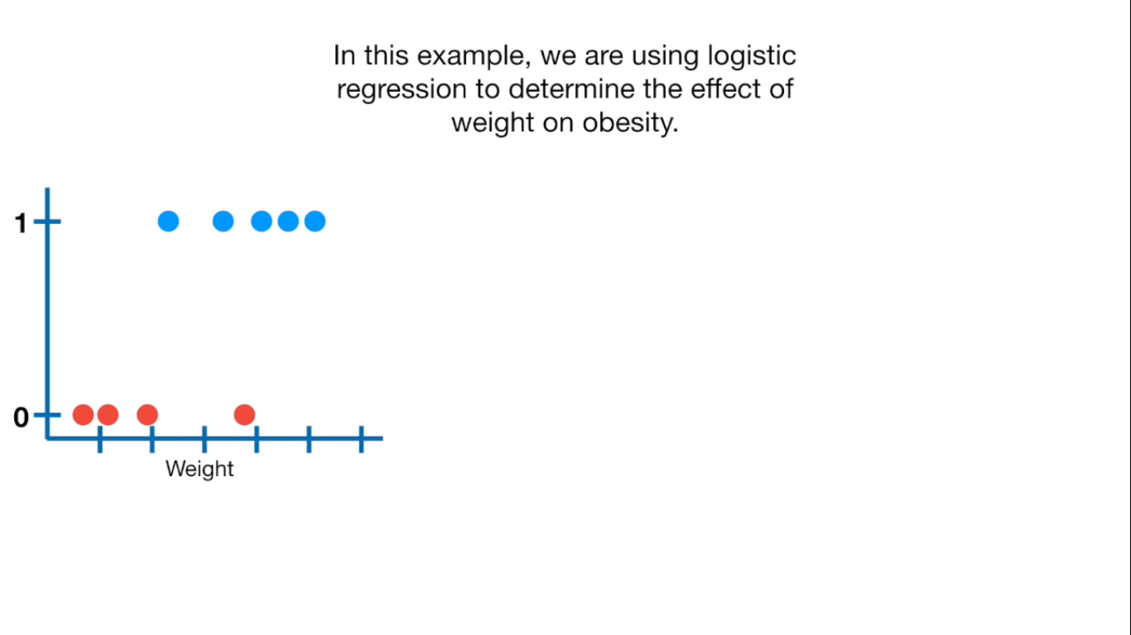

Slide 17
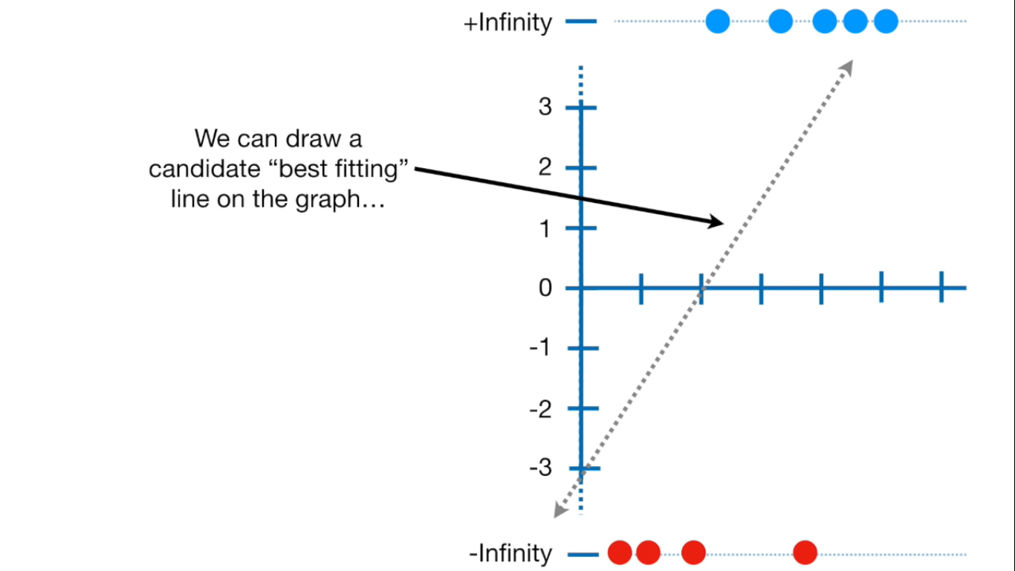

Slide 18
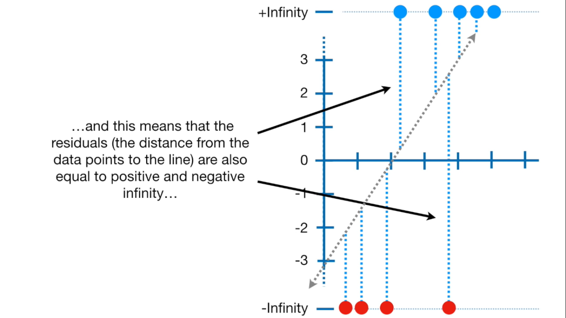

Slide 19
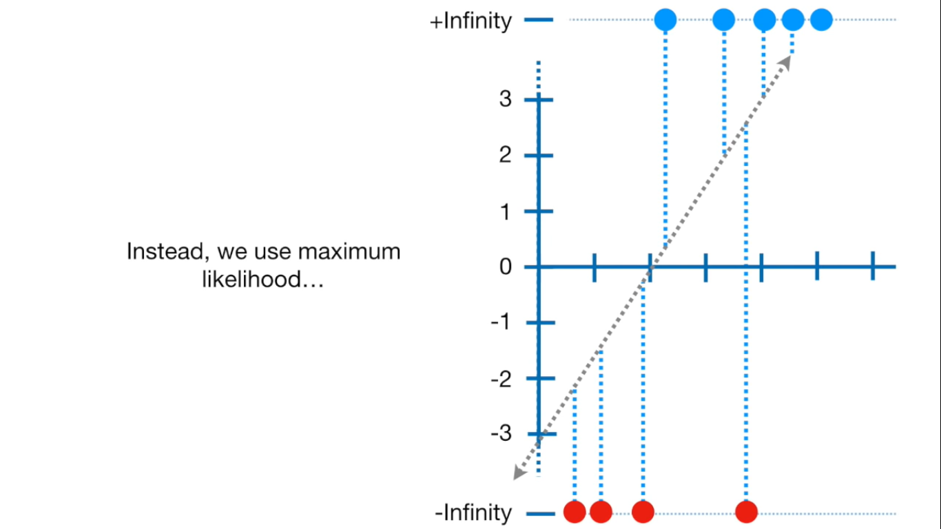

Slide 20
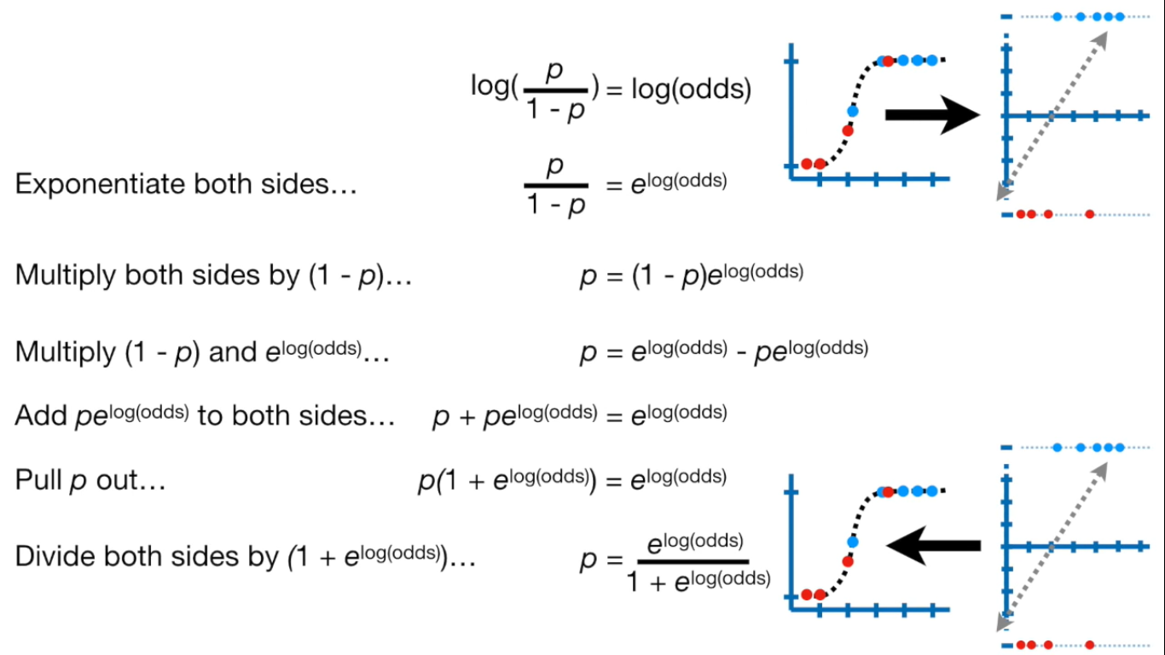

Slide 21
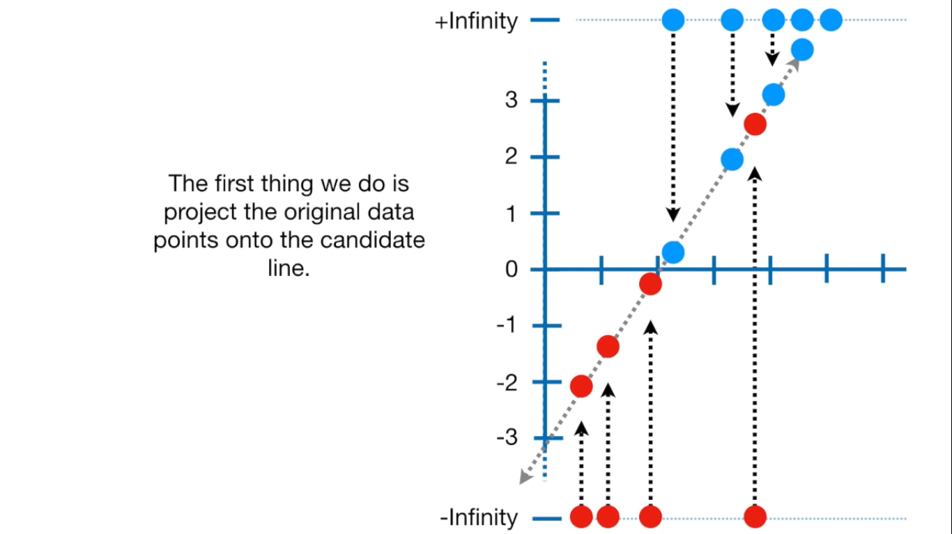

Slide 22
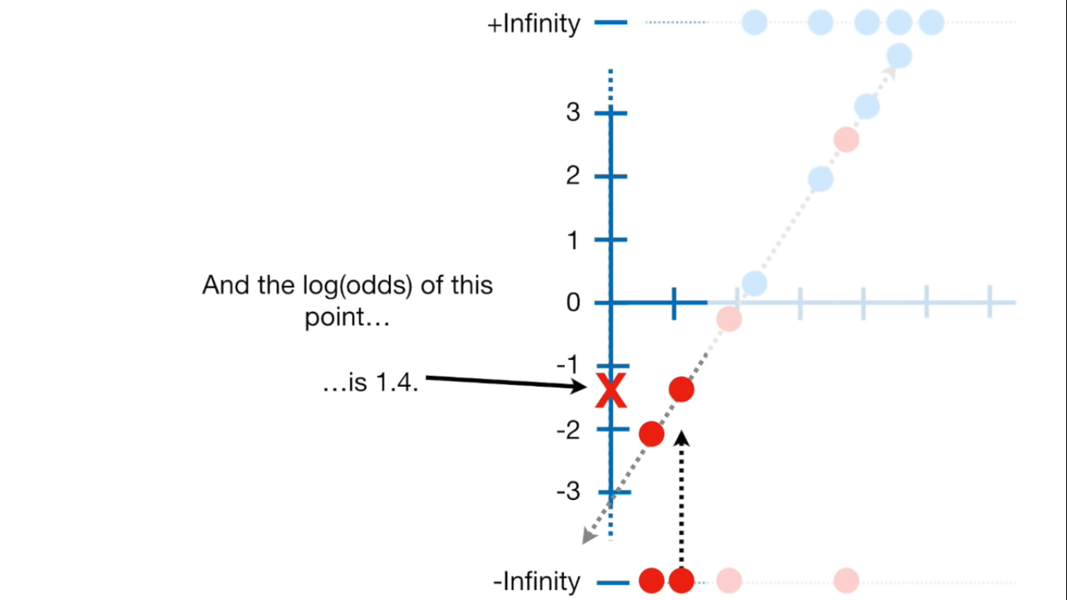

Slide 23
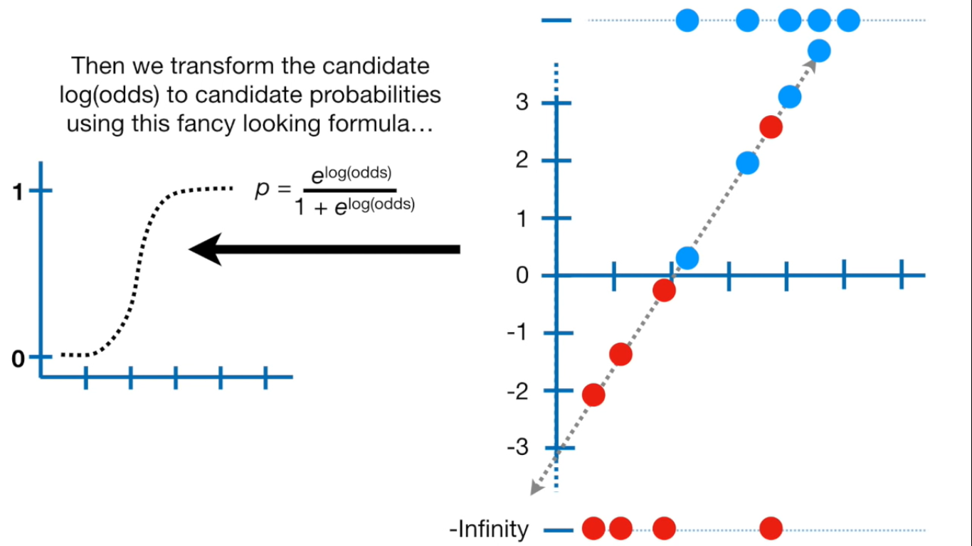

Slide 24
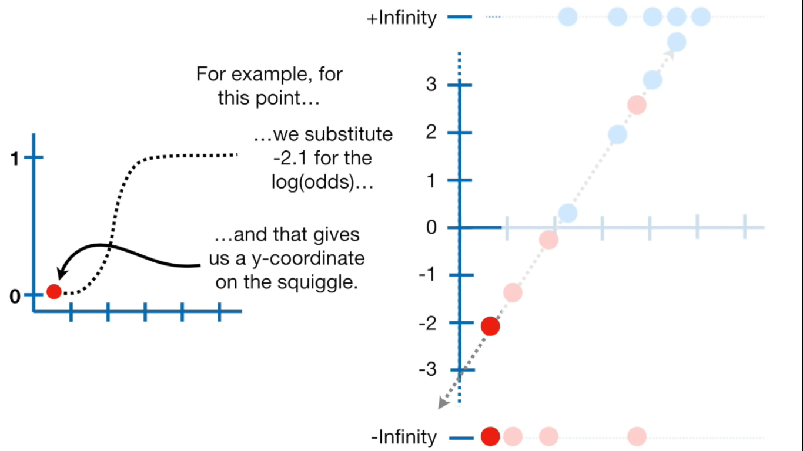

Slide 25
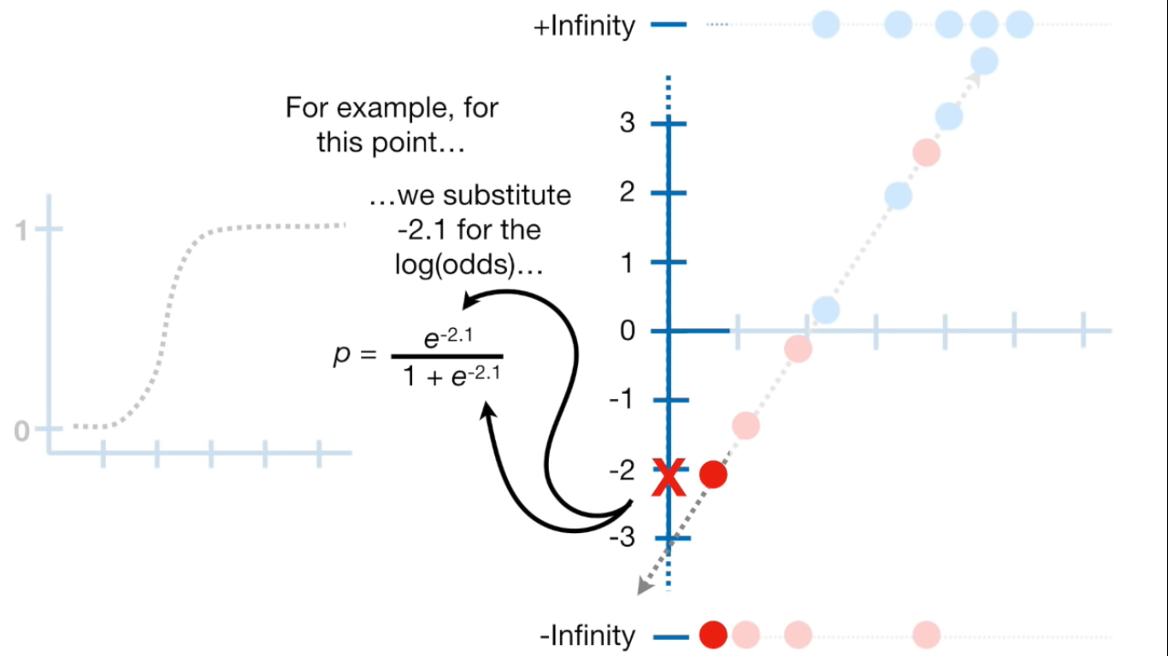

Slide 26
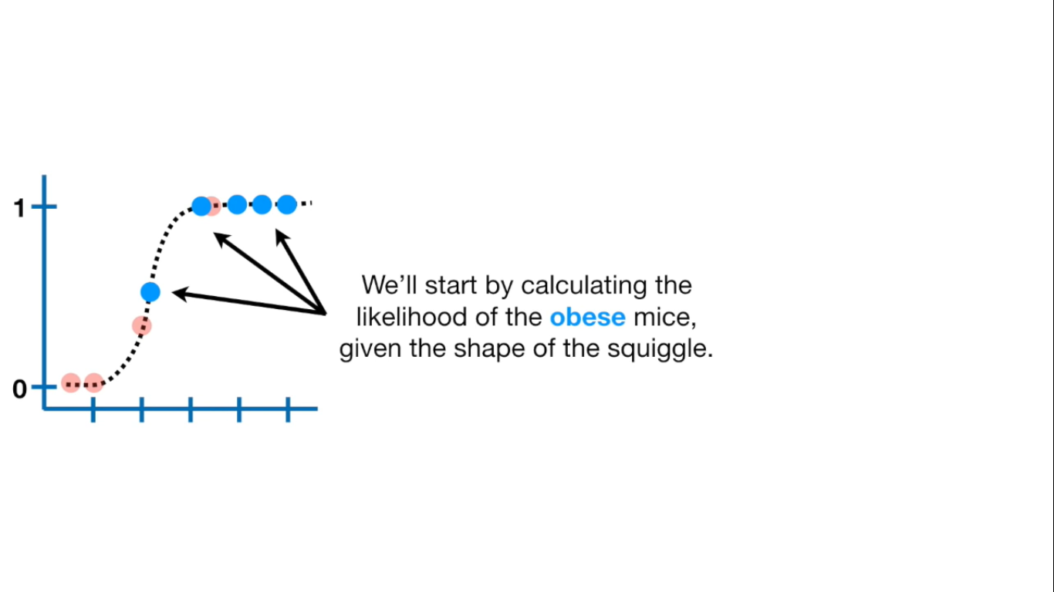

Slide 27
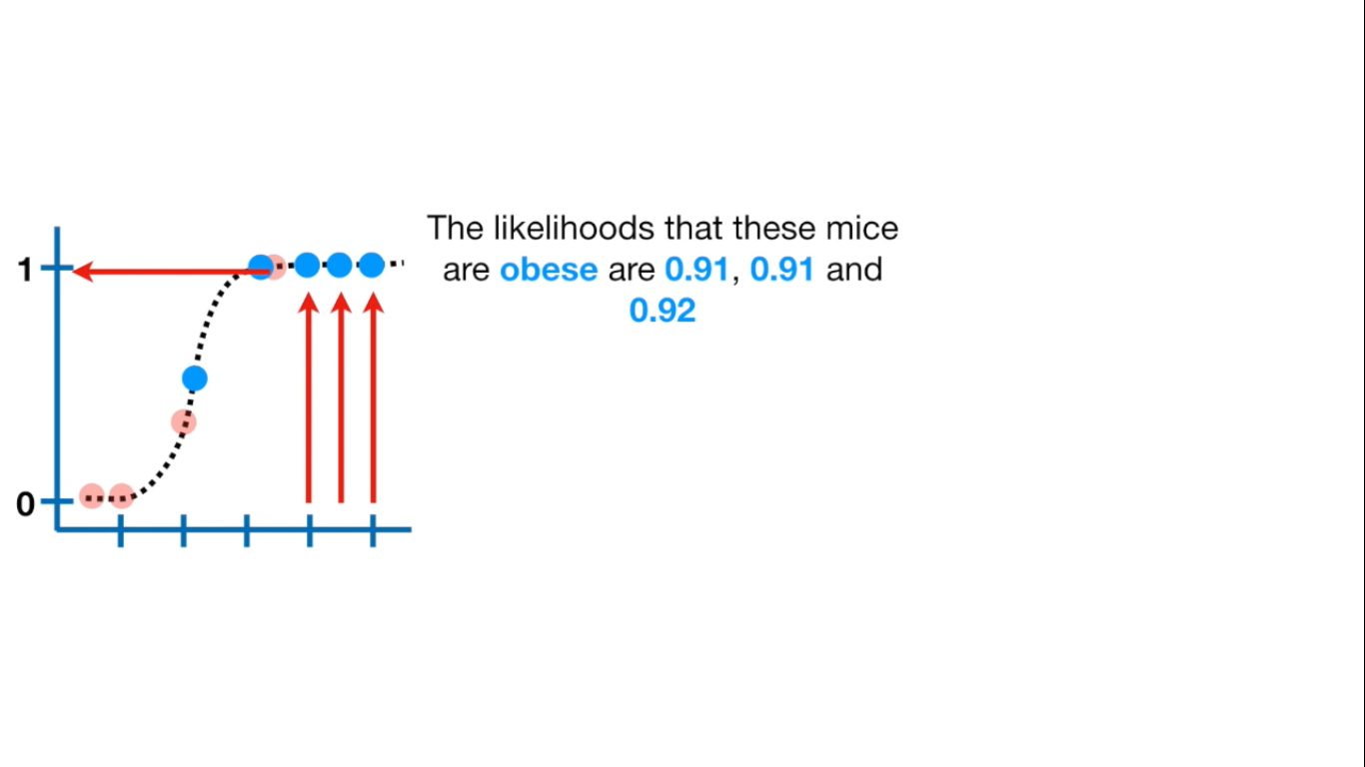

Slide 28
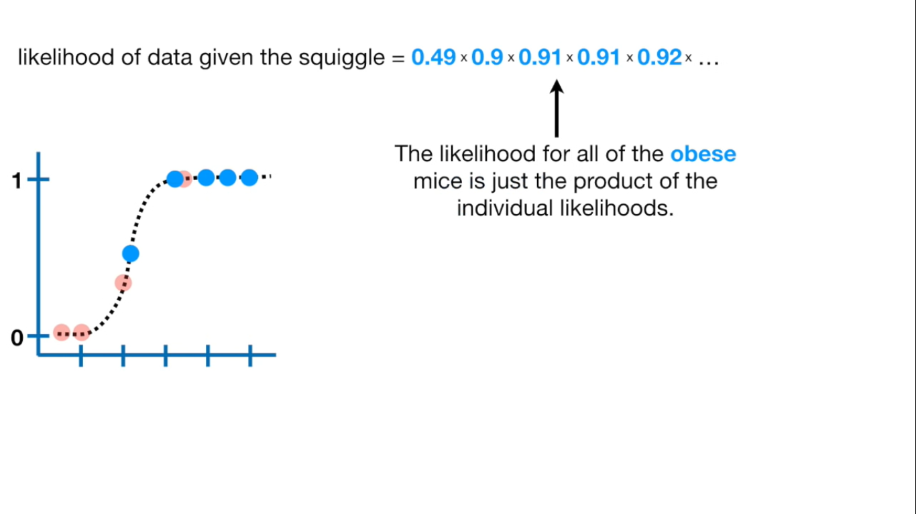

Slide 29
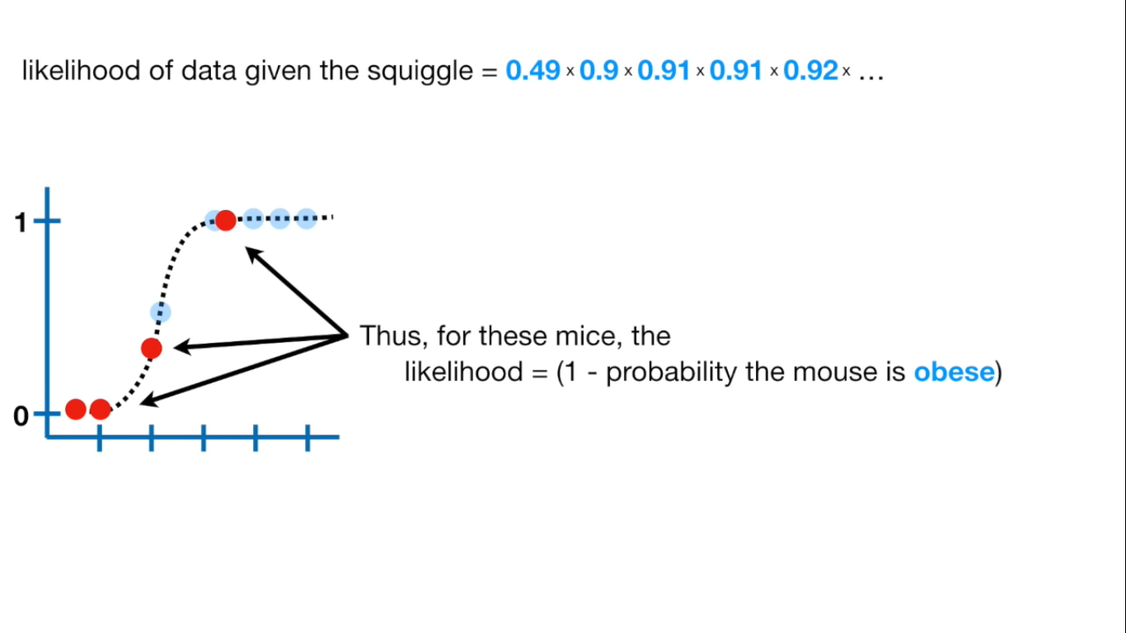

Slide 30
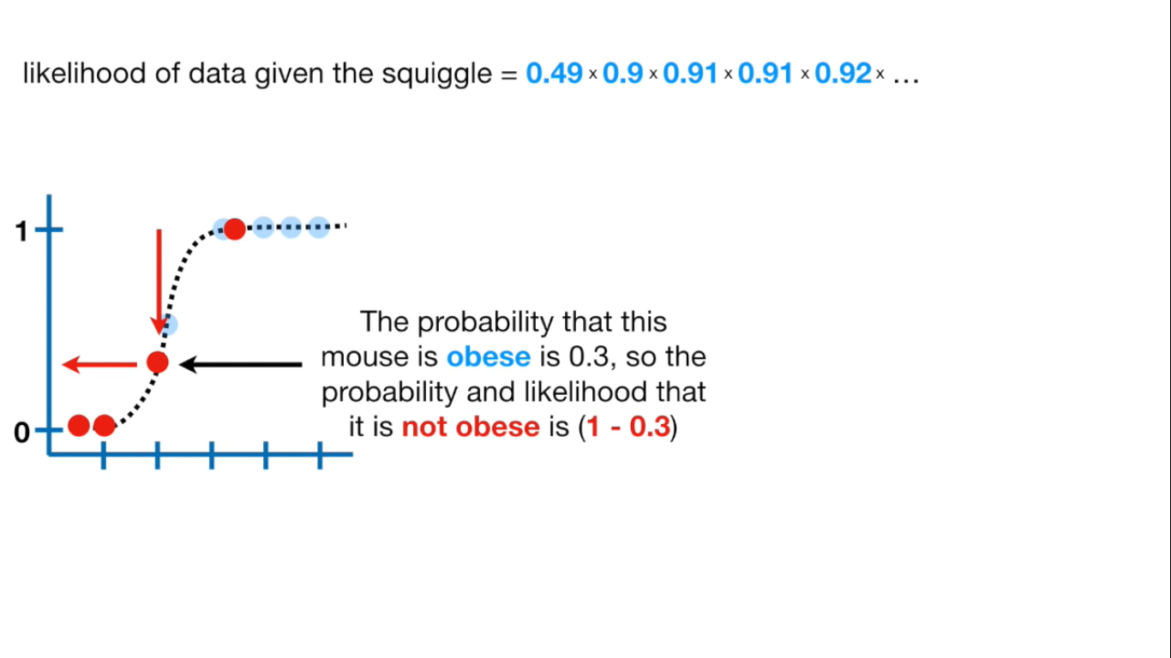

Slide 31
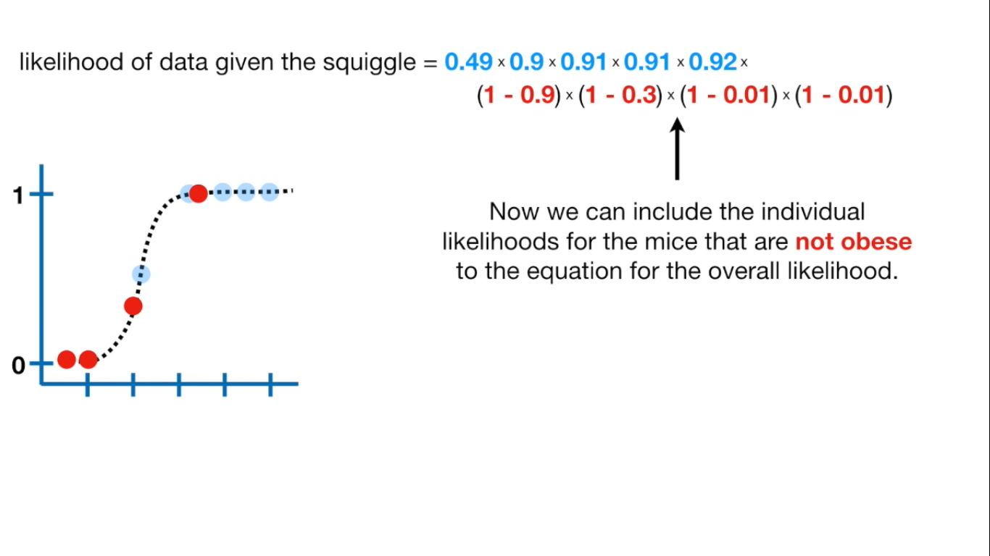

Slide 32
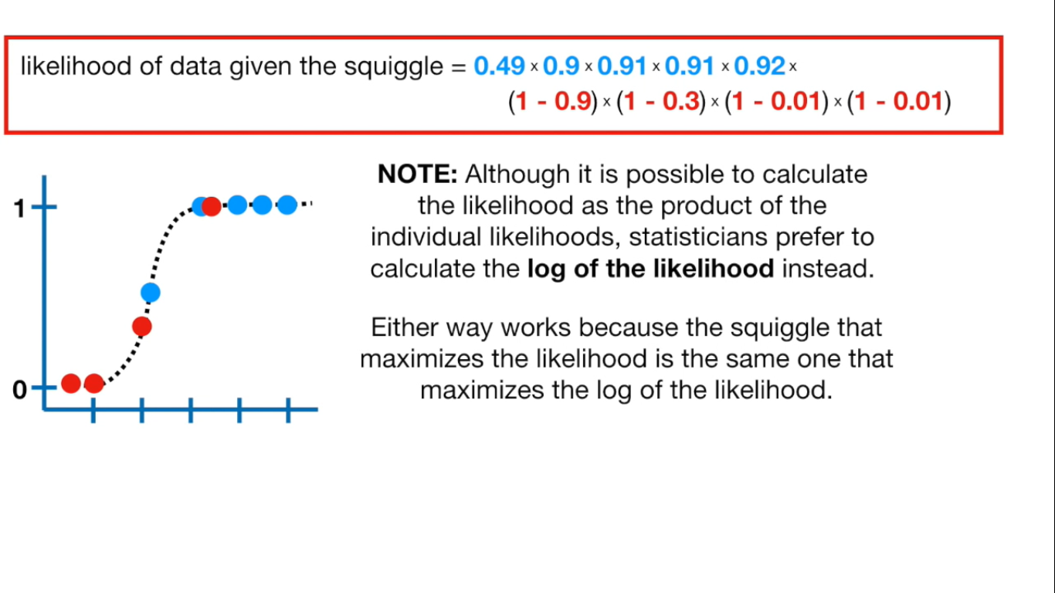

Slide 33
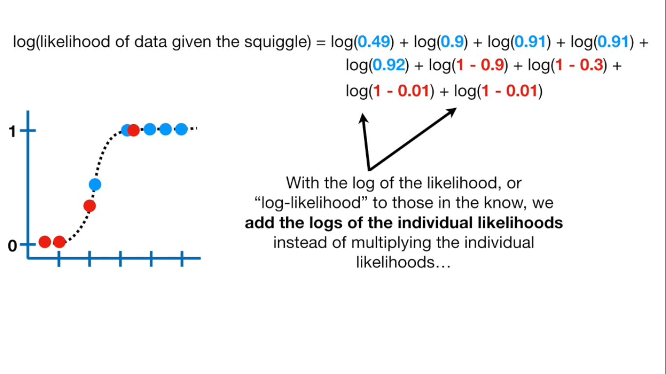

Slide 34
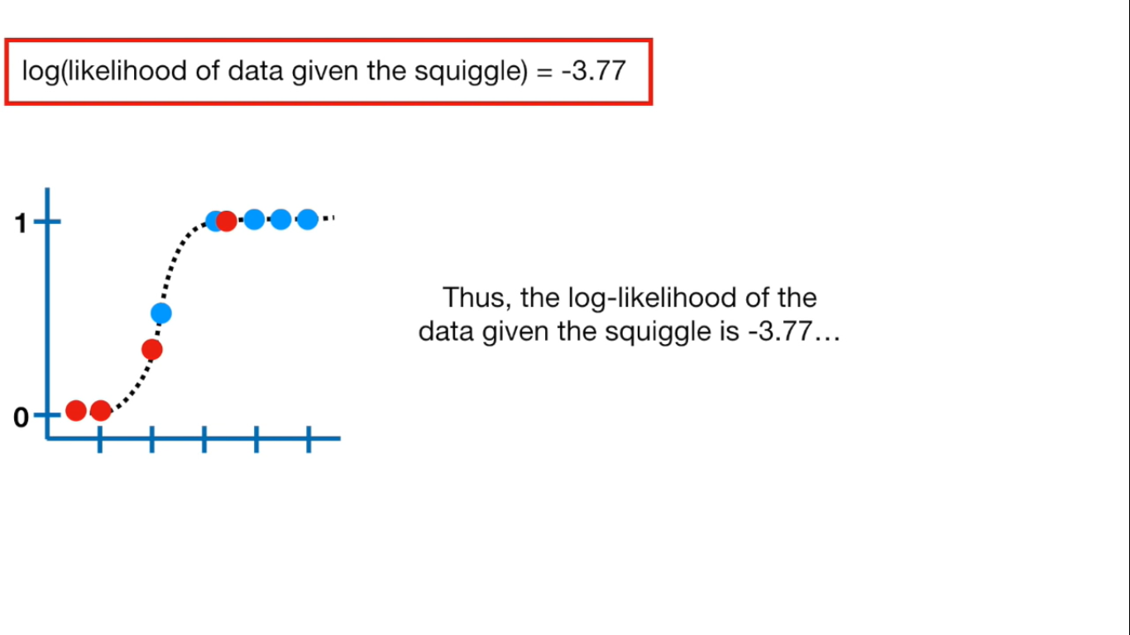

Slide 35
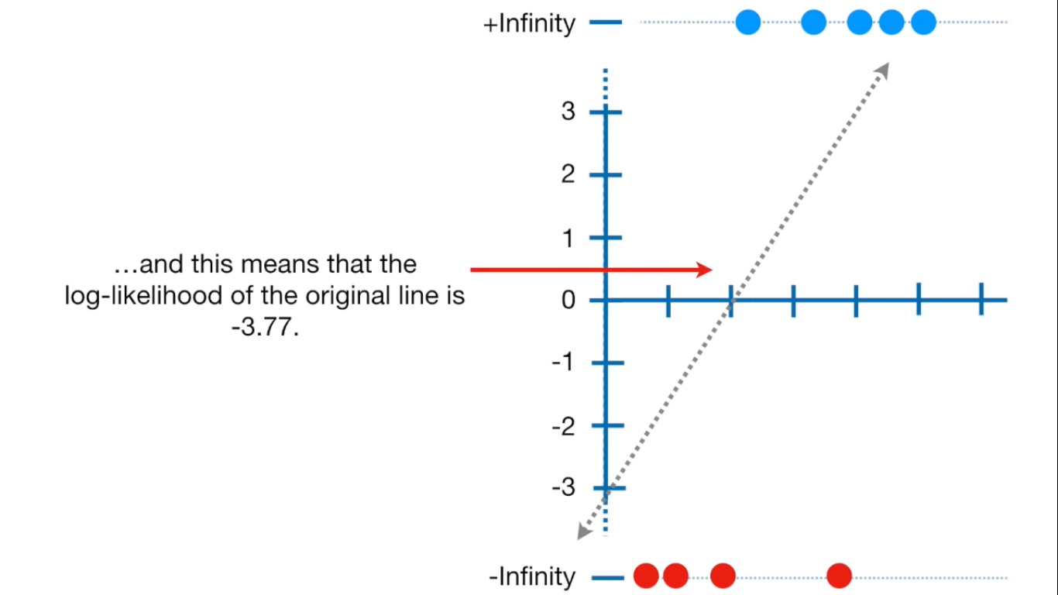

Slide 36
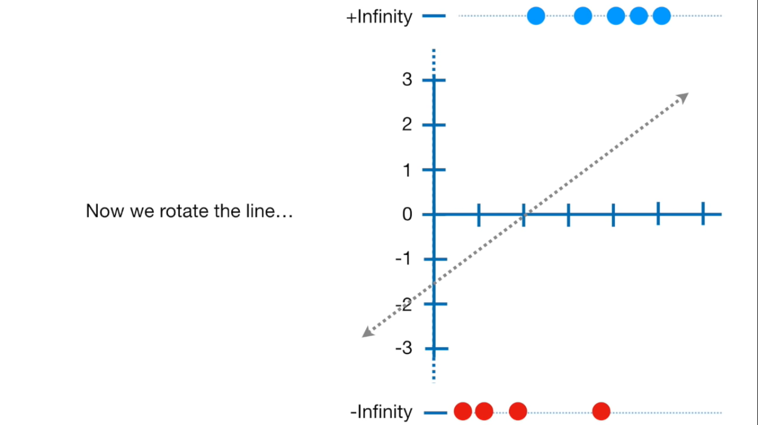

Slide 37
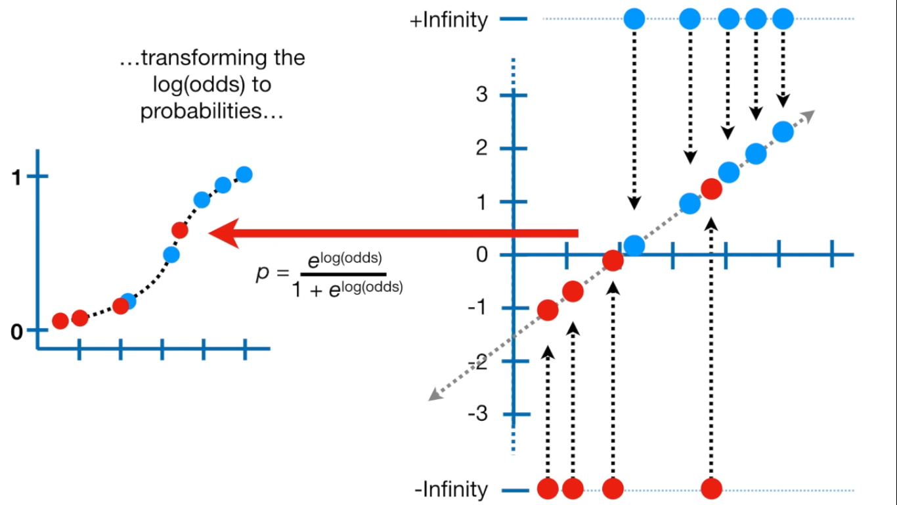

Slide 38
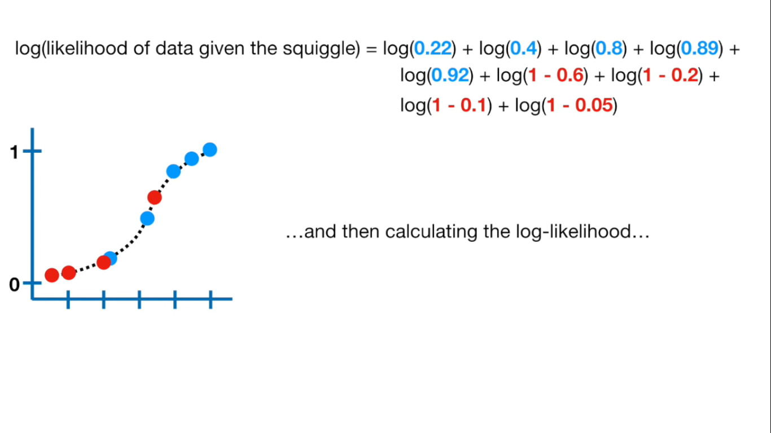

Slide 39
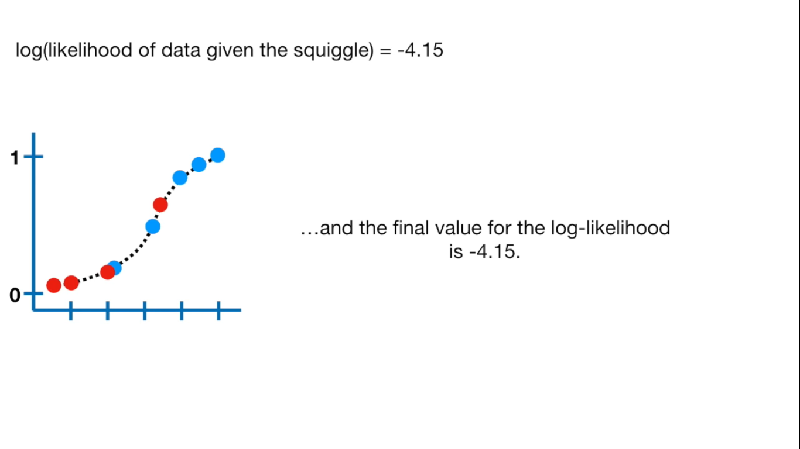

Slide 40
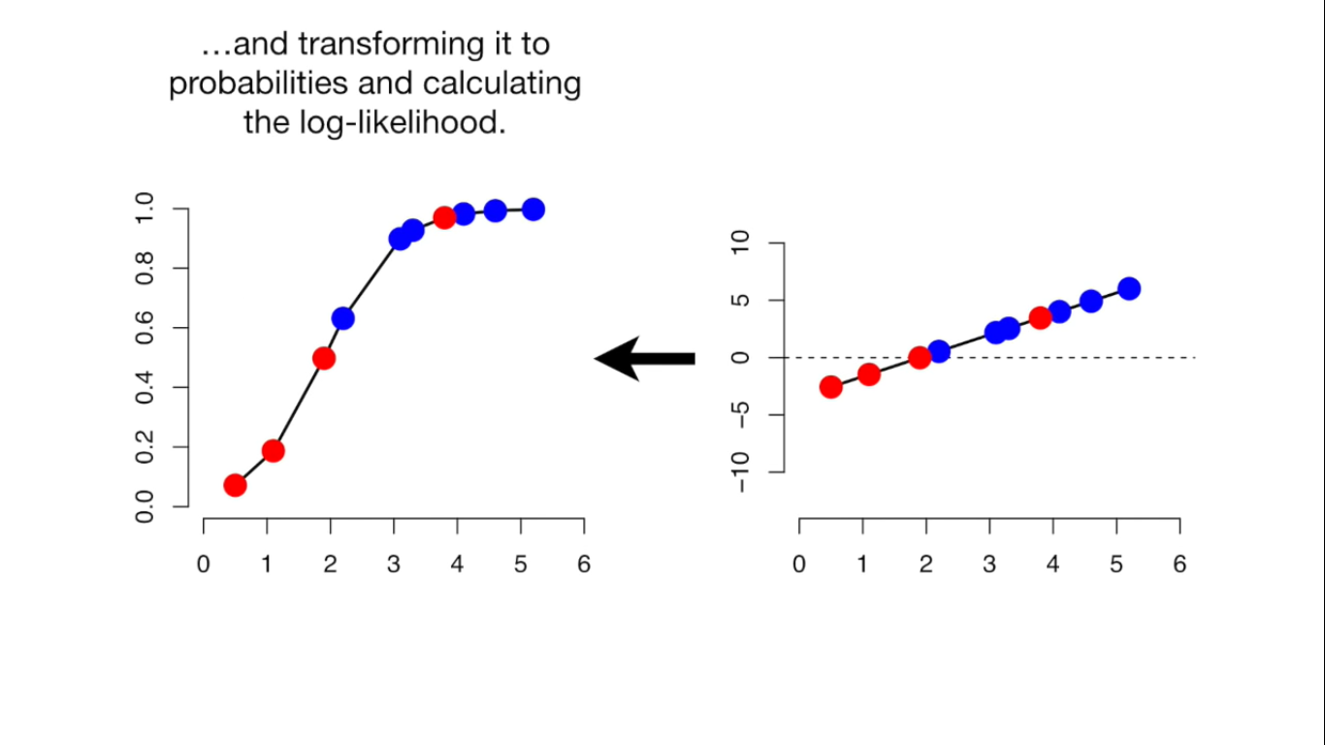

Slide 41
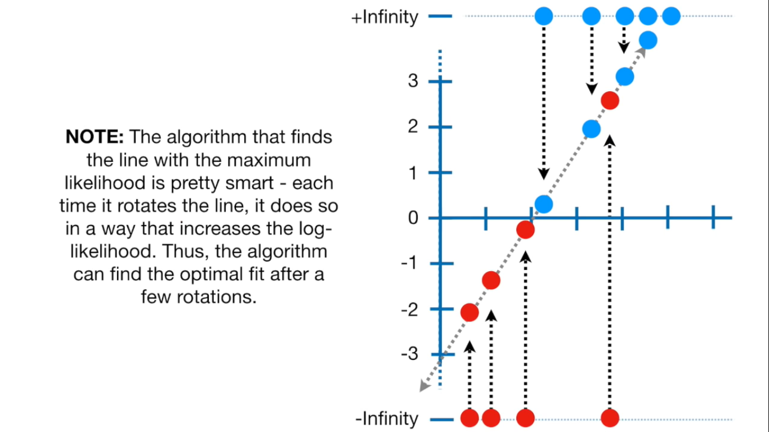

Slide 42
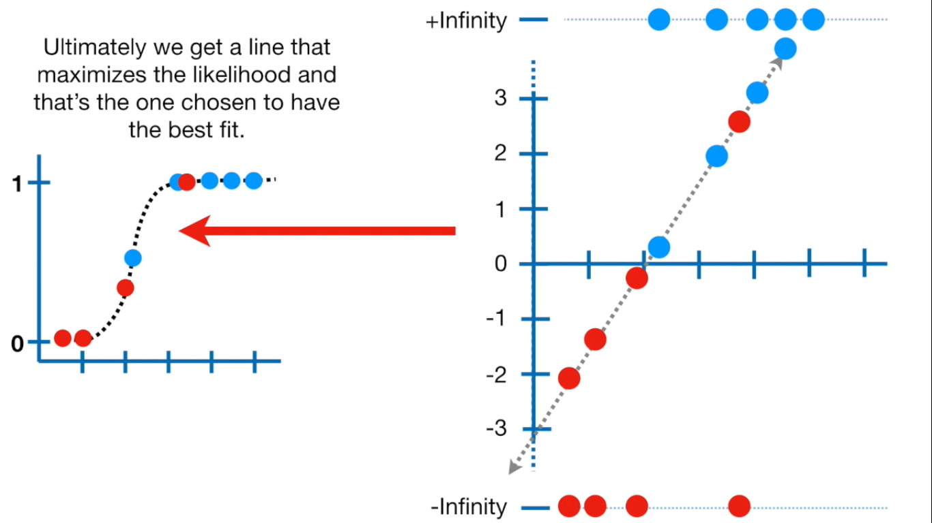

Slide 43
Why is accuracy not a good measure for classification problems?
Accuracy is not a good measure for classification problems because it gives equal importance to both false positives and false negatives. However, this may not be the case in most business problems. For example, in case of cancer prediction, declaring cancer as benign is more serious than wrongly informing the patient that he is suffering from cancer. Accuracy gives equal importance to both cases and cannot differentiate between them.

Slide 44
What is the importance of a baseline in a classification problem?
Most classification problems deal with imbalanced datasets. Examples include telecom churn, employee attrition, cancer prediction, fraud detection, online advertisement targeting, and so on. In all these problems, the number of the positive classes will be very low when compared to the negative classes. In some cases, it is common to have positive classes that are less than 1% of the total sample. In such cases, an accuracy of 99% may sound very good but, in reality, it may not be.
Here, the negatives are 99%, and hence, the baseline will remain the same. If the algorithms predict all the instances as negative, then also the accuracy will be 99%. In this case, all the positives will be predicted wrongly, which is very important for any business. Even though all the positives are predicted wrongly, an accuracy of 99% is achieved. So, the baseline is very important, and the algorithm needs to be evaluated relative to the baseline.

Slide 45
True positives and true negatives
true positives (TP): These are cases in which we predicted yes (they have the disease), and they do have the disease.
true negatives (TN): We predicted no, and they don't have the disease.
false positives (FP): We predicted yes, but they don't actually have the disease. (Also known as a "Type I error.")
false negatives (FN): We predicted no, but they actually do have the disease. (Also known as a "Type II error.")

Slide 46
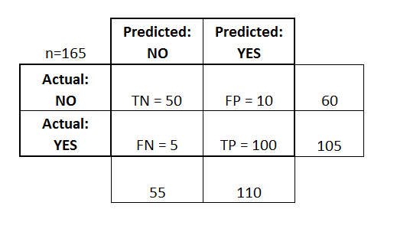
Confusion matrix

Slide 48
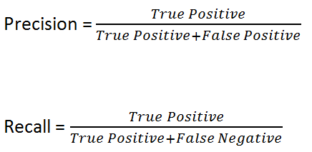
Precision and recall

Slide 49
Different measures of classification
Accuracy: Overall, how often is the classifier correct?(TP+TN)/total = (100+50)/165 = 0.91
True Positive Rate: When it's actually yes, how often does it predict yes?TP/actual yes = 100/105 = 0.95
also known as "Sensitivity" or "Recall“
False Positive Rate: When it's actually no, how often does it predict yes?FP/actual no = 10/60 = 0.17
True Negative Rate: When it's actually no, how often does it predict no?TN/actual no = 50/60 = 0.83
equivalent to 1 minus False Positive Rate also known as "Specificity“.
Precision: When it predicts yes, how often is it correct?TP/predicted yes = 100/110 = 0.91

Slide 50
How to choose a cutoff point in case of a logistic regression model?
The cutoff point depends on the business objective. Depending on the goals of your business, the cutoff point needs to be selected. For example, let’s consider loan defaults.
If the business objective is to reduce the loss, then the specificity needs to be high. If the aim is to increase profits, then it is an entirely different matter. It may not be the case that profits will increase by avoiding giving loans to all predicted default cases.
But it may be the case that the business has to disburse loans to default cases that are slightly less risky to increase the profits. In such a case, a different cutoff point, which maximises profit, will be required.
In most of the instances, businesses will operate around many constraints. The cutoff point that satisfies the business objective will not be the same with and without limitations.
The cutoff point needs to be selected considering all these points. As a thumb rule, choose a cutoff value that is equivalent to the proportion of positives in a dataset.

Slide 51
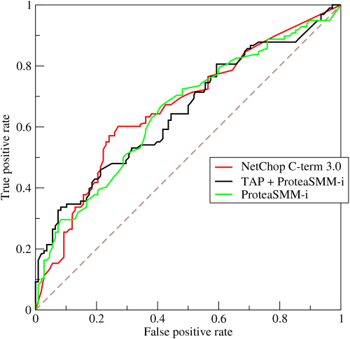

Slide 52
Threshold = 0.5 : 0.6,0.4
Threshold = 0.4 : 0.7, 0.3
Threshold = 0.55 : TPR3, FPR3
TPR
FPR

